Slide 1

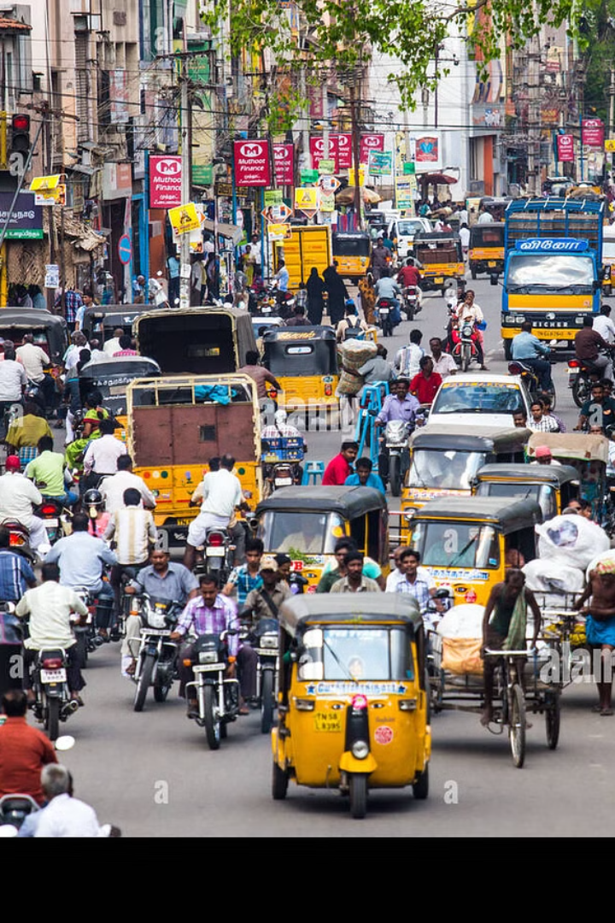
IndiaRide – Vehicle Rental System
Presented by: Aditya Singh (RA2211030010034)
Priyanshu Singh (RA2211030010036)
Notes:
1

Slide 2
Introduction to IndiaRide
What is IndiaRide?
Why is it needed?
A web platform connecting vehicle owners with renters.
Traditional rental systems lack security, availability, and efficiency.
Seamless bookings, flexible rentals, secure transactions.
No unified system benefiting both renters and owners.
Notes:
2

Slide 3
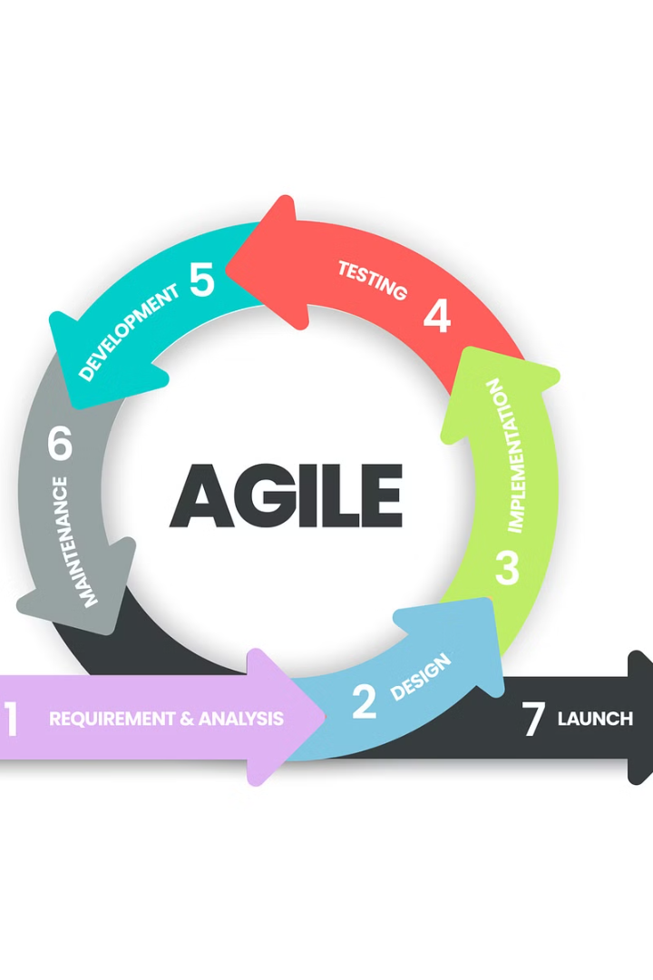

Agile Methodology Overview
1
What is Agile?
Iterative development approach focused on flexibility and collaboration.
2
Why Agile for IndiaRide?
Enables quick adaptation to changing user needs.
Continuous improvements through sprint-based development.
Notes:
3

Slide 4
Agile Development Process
Sprint 1
1
UI/UX design, database setup.
2
Sprint 2
User authentication, vehicle listing, booking system.
Sprint 3
3
Payment gateway integration, security verification.
4
Sprint 4
Notifications, reviews, and ratings system.
Sprint 5
5
Performance optimization and cloud deployment.
Notes:
4

Slide 5

User Stories & Requirements Gathering
Renter Story
Owner Story
Browse available vehicles near my location to make quick bookings.
Secure system to verify renters before confirming bookings.
Admin Story
Monitor transactions to ensure fraud prevention.
Notes:
5

Slide 6
System Architecture & Technology Stack
Microservices Architecture
Event-Driven Approach
Backend: Django, Frontend: HTML, CSS, JavaScript.
Kafka/RabbitMQ for instant notifications and booking updates.
Database: PostgreSQL/MySQL & MongoDB, Deployment: AWS/Azure with Docker & Kubernetes.
Notes:
6

Slide 7
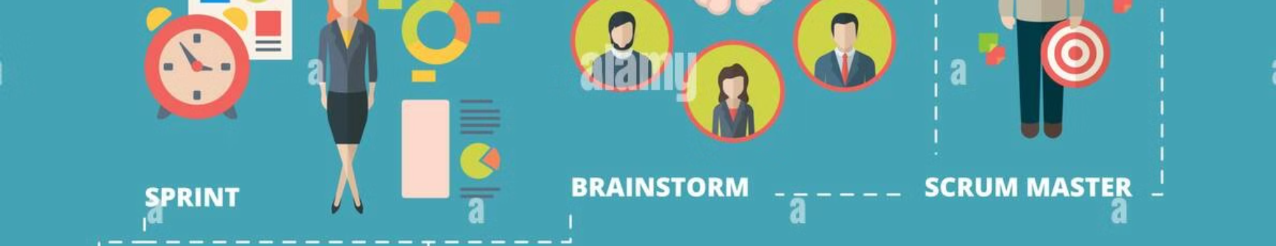



Sprint Execution & Collaboration
Daily Standups for progress updates and blockers.
Sprint Reviews to showcase completed features for feedback.
Retrospectives for reflecting on past sprints and continuous improvement.
Notes:
7

Slide 8





Challenges & How Agile Helped
Challenge 1
Challenge 2
Challenge 3
Agile Solution
Evolving user requirements and security concerns.
Ensuring a scalable architecture for high demand.
Managing payment integration and real-time booking without lag.
Frequent iterations allowed feature adjustments based on feedback.
Incremental development reduced risks and improved system stability.
Sprint retrospectives helped refine the process continuously.
Notes:
8

Slide 9


Final Deliverables & Future Scope
Current Status
Fully functional web application.
1
Scalable backend with microservices architecture.
Integrated authentication, notifications, and real-time tracking.
Future Enhancements
AI-driven dynamic pricing and demand forecasting.
2
Expansion to EV rentals and sustainable mobility solutions.
Development of a mobile app for seamless rentals on the go.
Notes:
9

Slide 10

Thank You
We're proud of the IndiaRide project and its potential impact.
We welcome questions and discussions regarding our vision for future growth.
Notes:
10

